Slide 1


UNIT 7: On top of the world
Simply the best 1

Slide 2
How many of you have got a pet?
What kind of a pet have you got?
What is your pet worst at?
What is your pet best at?

Slide 3
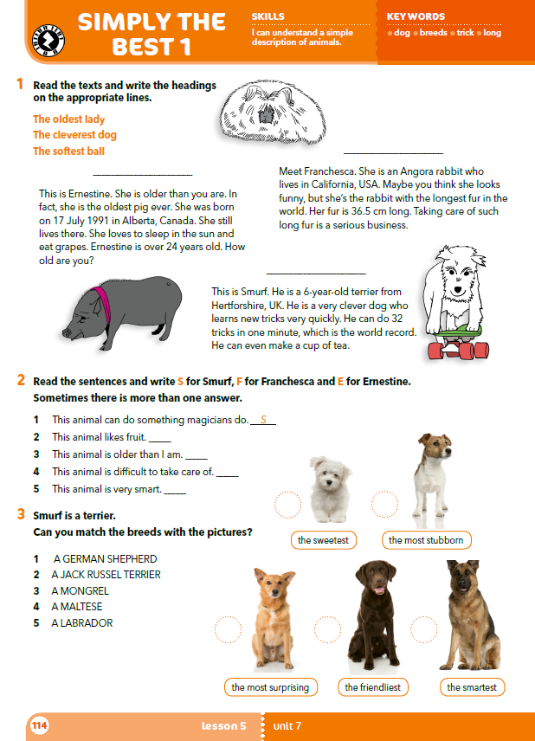
What animals can you see?
What do you think makes them special?

Slide 4
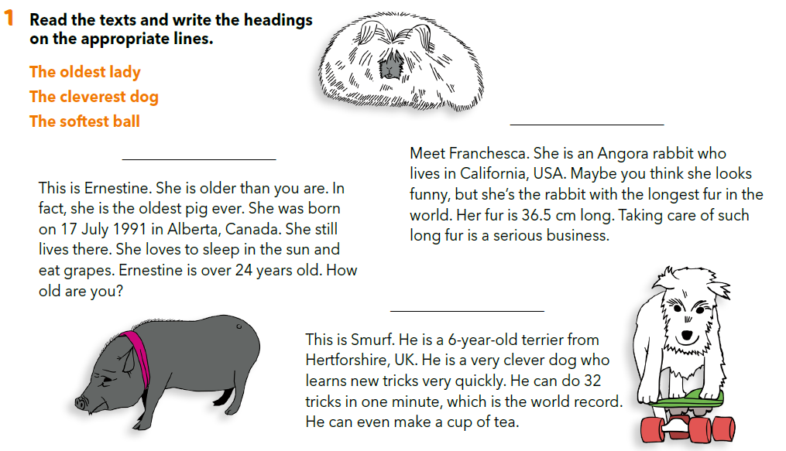
The softest ball
The oldest lady
The cleverest dog

Slide 5
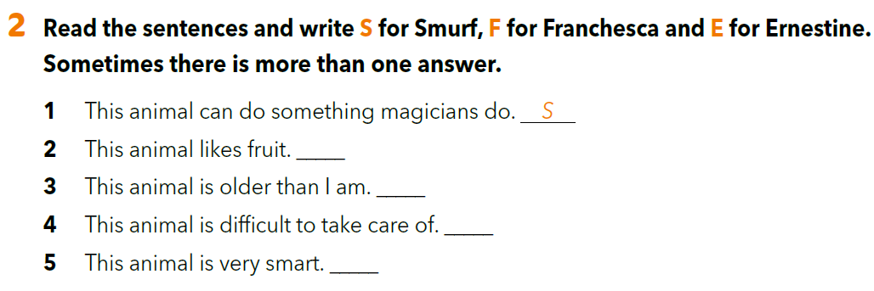
E
E
F
S

Slide 6
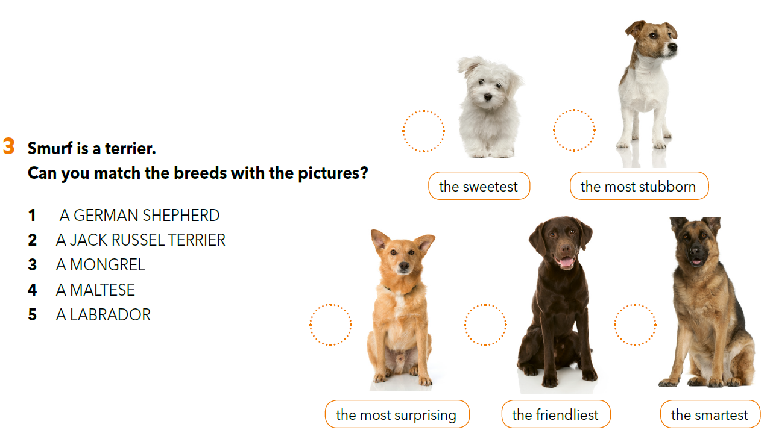
4
2
3
5
1
Do you know anything about these breeds (a german shepherd, a Jack Russel terrier…)?

Slide 7
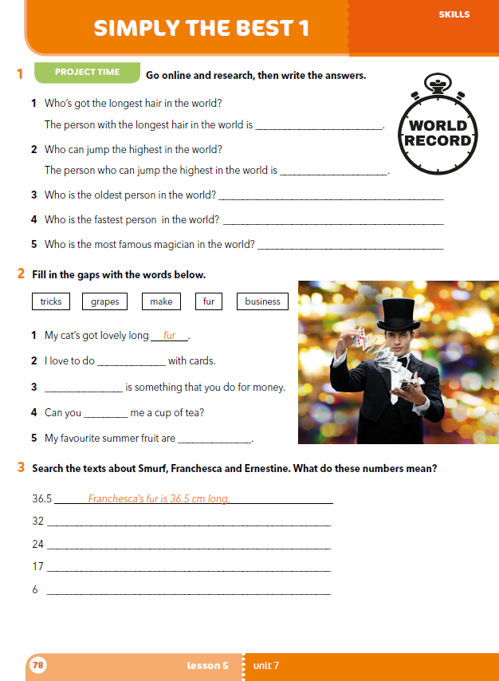
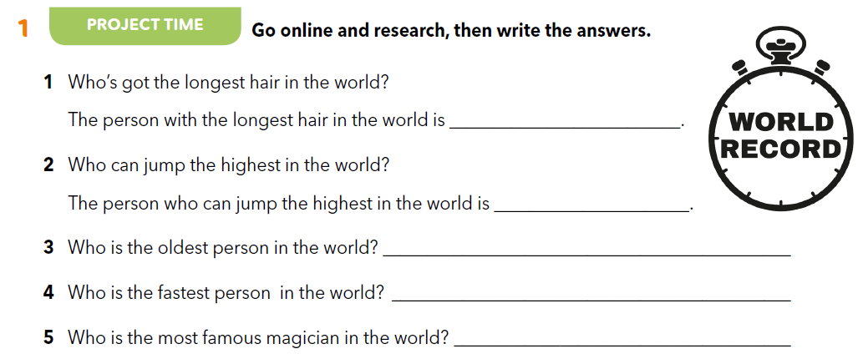
Workbook p. 78
Xie Quiping
Brett Williams
Kane Tanaka
Christian Coleman
Houdini

Slide 8
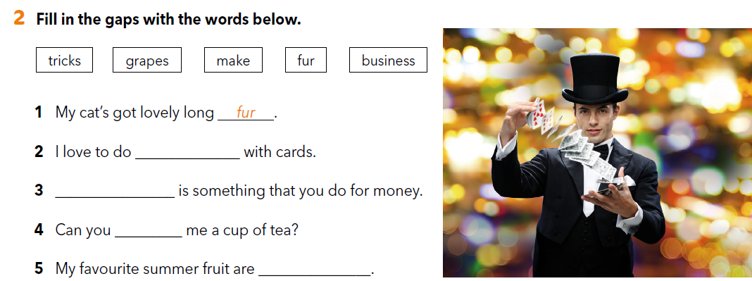
tricks
Business
make
grapes

Slide 9
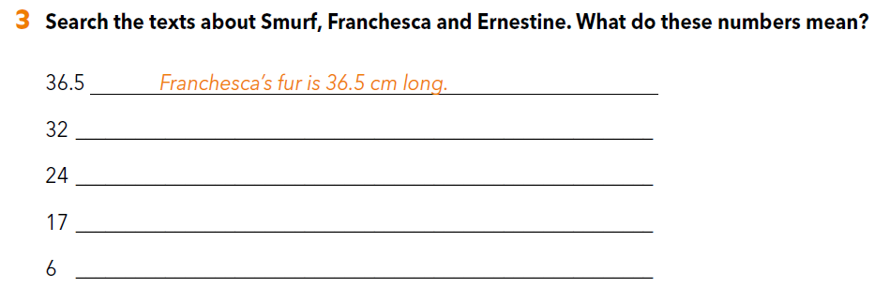
Smurf can do 32 tricks in one minute.
Ernestine is over 24 years old.
Ernestine was born on 17 July 1991.
Smurf is a 6-year-old terrier.

Slide 10

LEARN MORE
https://www.e-sfera.hr/dodatni-digitalni-sadrzaji/e5a07d70-84ca-4877-9eca-aba608335b27/
LARRY

